Slide 1
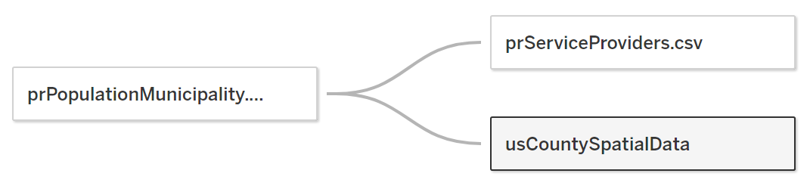
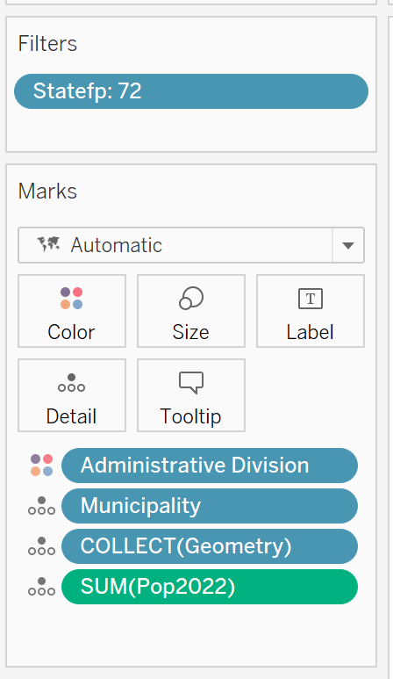
PUERTO RICO POPULATION VISUALIZATION
Steps to Create Visualization with Tableau Public
1
Collect, identify, and prepare data sources
prPopulationMunicipality.csv
Municipality
Administrative Division
Territory
Pop2020
Pop2021
Pop2022
prServiceProviders.csv
Service Provider
Municipality
Lat
Lon
tl_2019_us_county RENAME usCountySpatial
tl_2019_us_county.cpg
tl_2019_us_county.dbf
tl_2019_us_county.prj
tl_2019_us_county.shp
tl_2019_us_county.shp.ea.iso.xml
tl_2019_us_county.shp.iso.xml
tl_2019_us_county.shx
Connect Tableau Public to data
Connect to a File or Add
Text file > prPopulationMunicipality.csv
Use Data Interpreter
Text file > prServiceProviders.csv
Use Data Interpreter
Spatial file > tl_2019_us_county.shp
3
Define relationships
prPopulationMunicipality$Municipality = prServiceProviders$Municipality
prPopulationMunicipality$Municipality = usCountySpatialData$Name
Switch to sheet (worksheet)
Create visualization (filters and marks)
4
5
2
prPopulationMunicipality
prPopulationMunicipality
usCountySpatial
prPopulationMunicipality

Slide 2
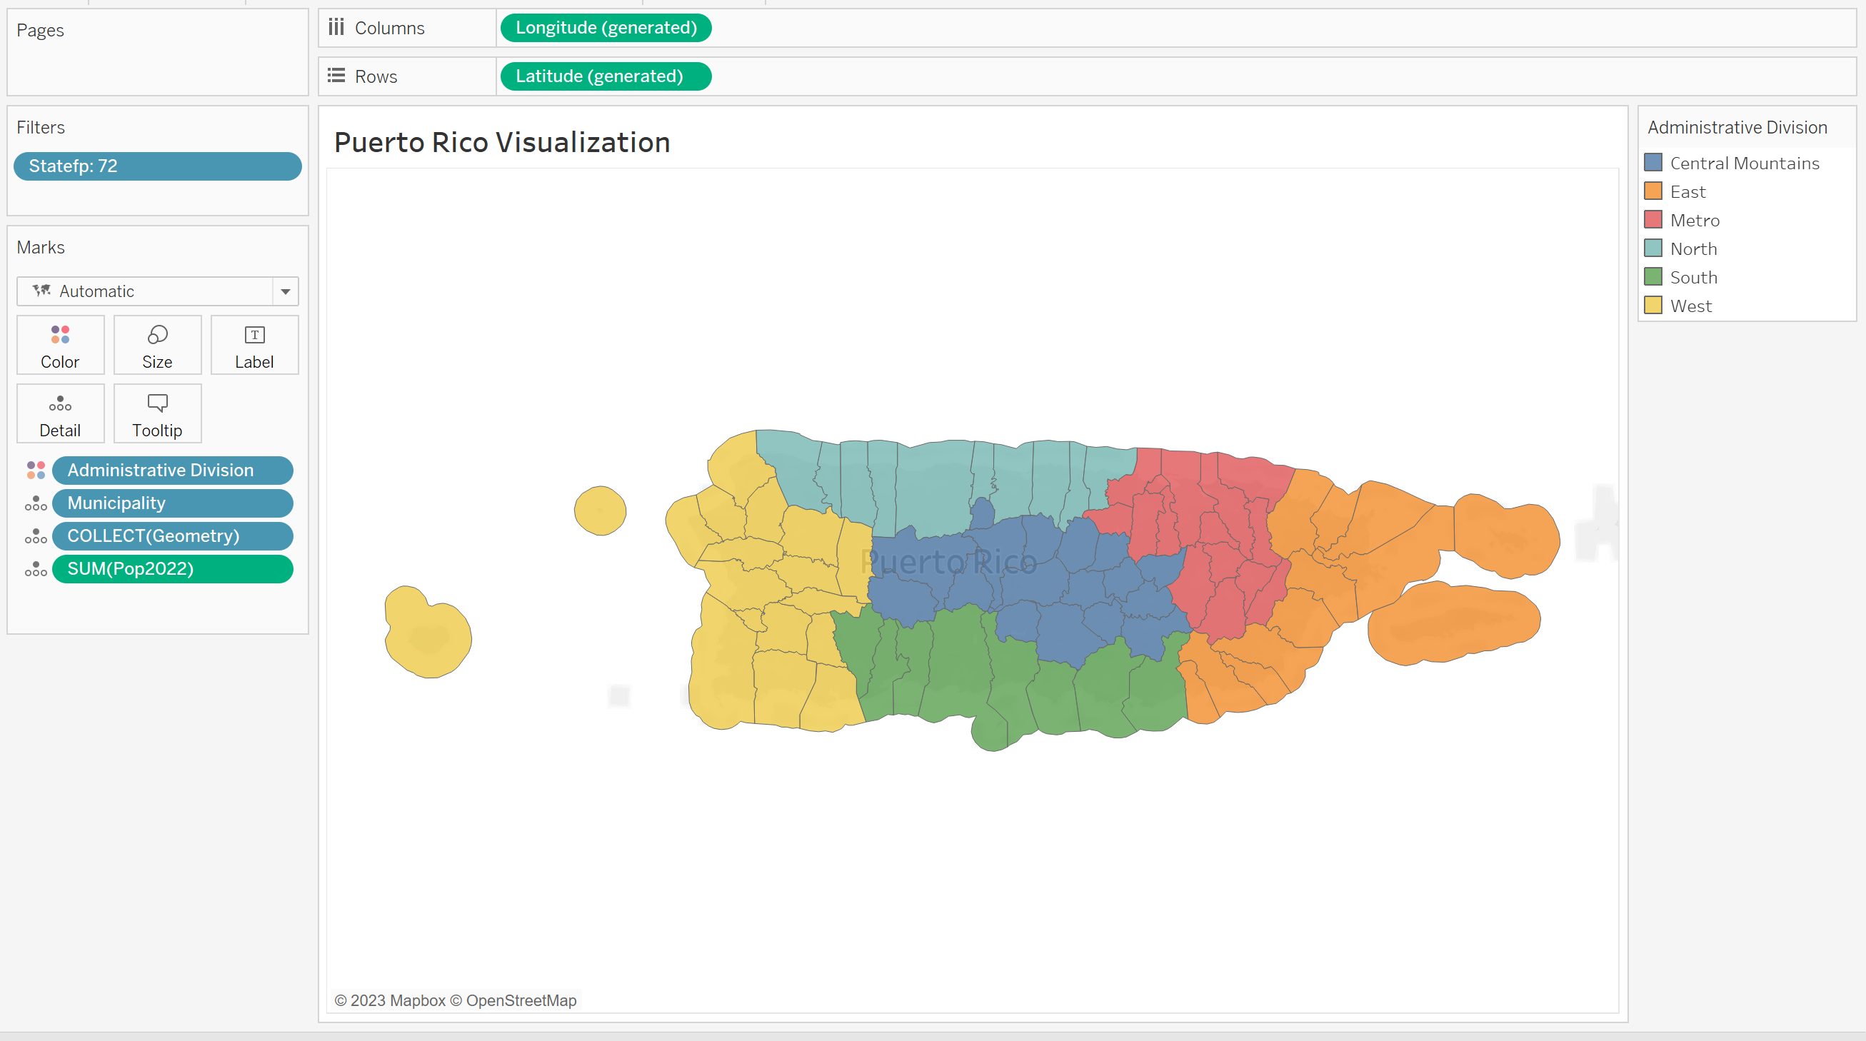
PUERTO RICO POPULATION VISUALIZATION
Puerto Rico Visualization | Tableau Public

